Slide 1
Boiler Hackattack: Covid-19 Vaccination Demographics CGT 270 Data Visualization Hackathon

Slide 2







Team Boiler Hackattack
Tejasvi Bhagwatkar
Major:
Web Programming and Design
Jason Estes
Major:
Web Programming and Design
Ben Habegger
Major:
UX Design
Bethany MaGee Major:
Web Programming and Design

Slide 3

Case Summary
We chose to do our project on the recent pandemic caused by COVID-19 and decided to take a closer look at how different demographics took to the vaccine.

Slide 4
Problem Statement
Information of the vaccine is often misconstrued or falsified to fit certain narratives. We want to show our audience how the vaccinated population of Indiana is broken down.

Slide 5
Audience & Assumption
Our audience is Indiana residents. We are trying to make our presentation accessible to most adults to give them an understanding of vaccination trends in Indiana counties.
Our assumption is that the audience does not have unbiased, accurate data regarding which demographics received the vaccination.

Slide 6

Our Questions
Which Indiana counties have the most fully vaccinated residents ?
How are vaccination numbers reflected in different demographics?
How does Indiana compare to other states?

Slide 7
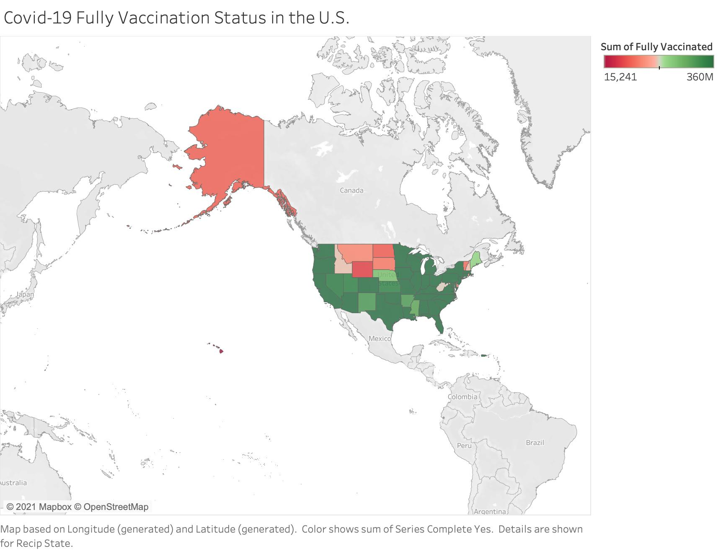
Fully Vaccinated Percentage per State in the U.S.

Slide 8
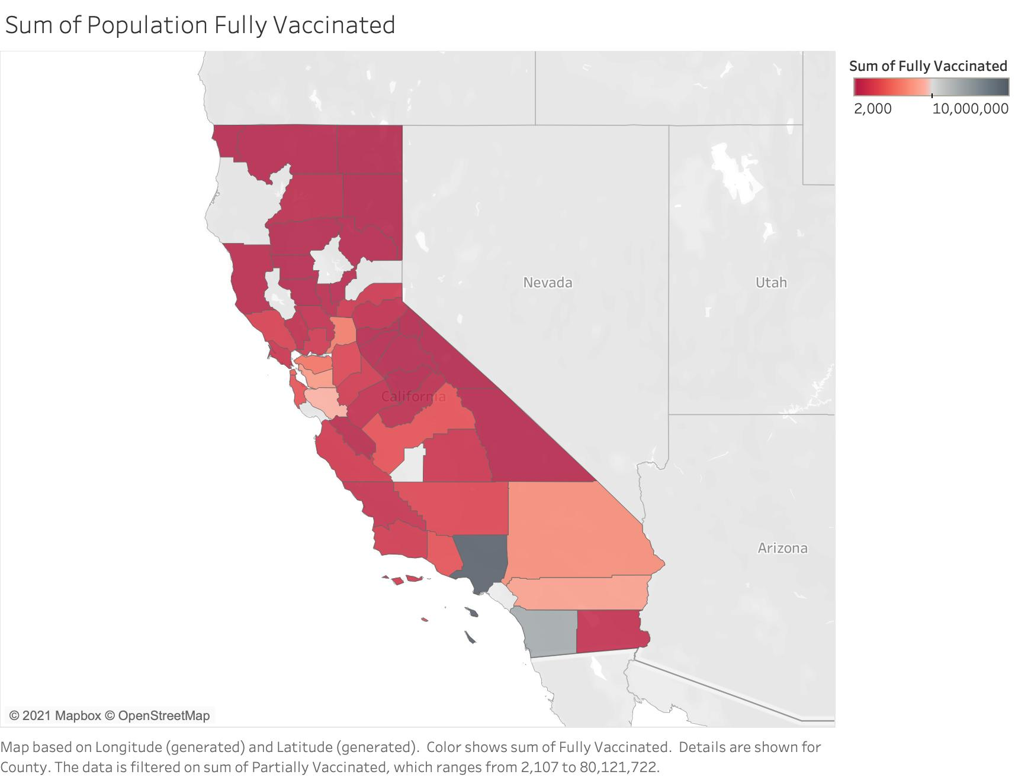
Fully Vaccination Sum in California

Slide 9
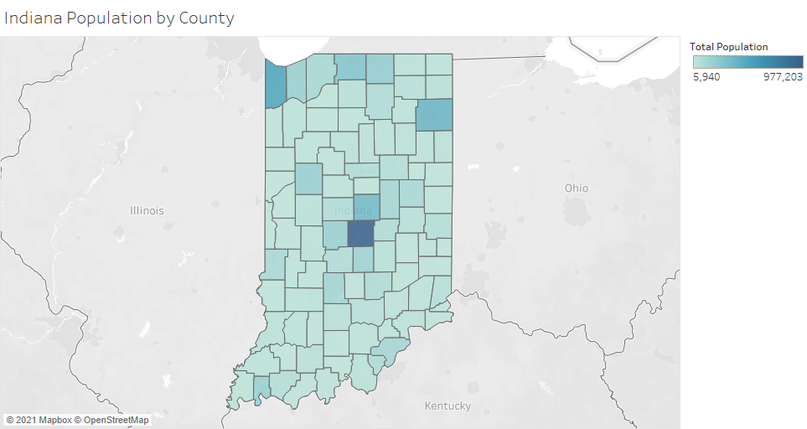
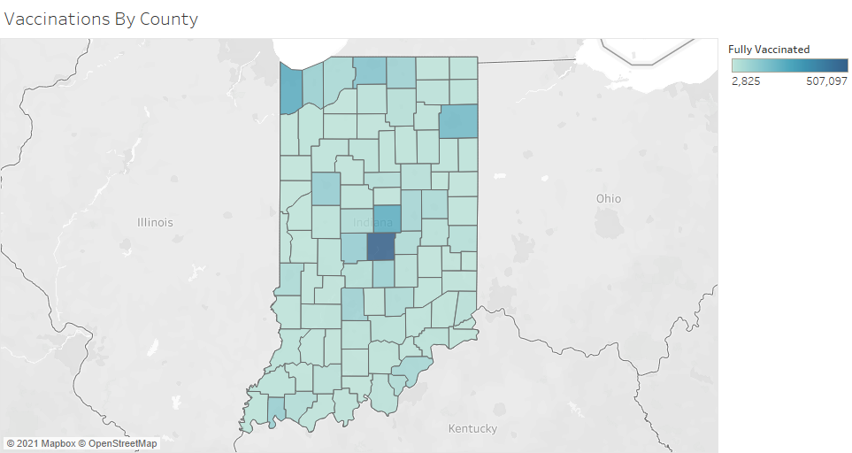
Indiana Vaccinations vs Population
Indiana’s Population by County and Vaccinations by County are nearly identical showing vaccination rates are consistent with population size.

Slide 10
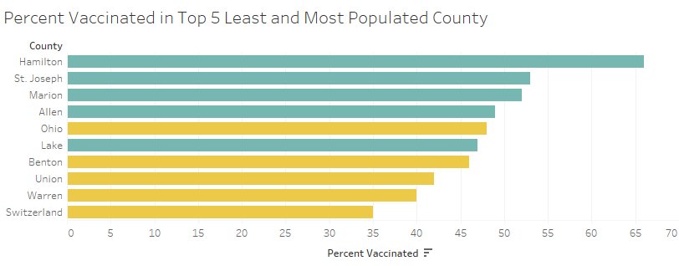

Top 5 Most Populous Counties vs Top 5 Least

Slide 11
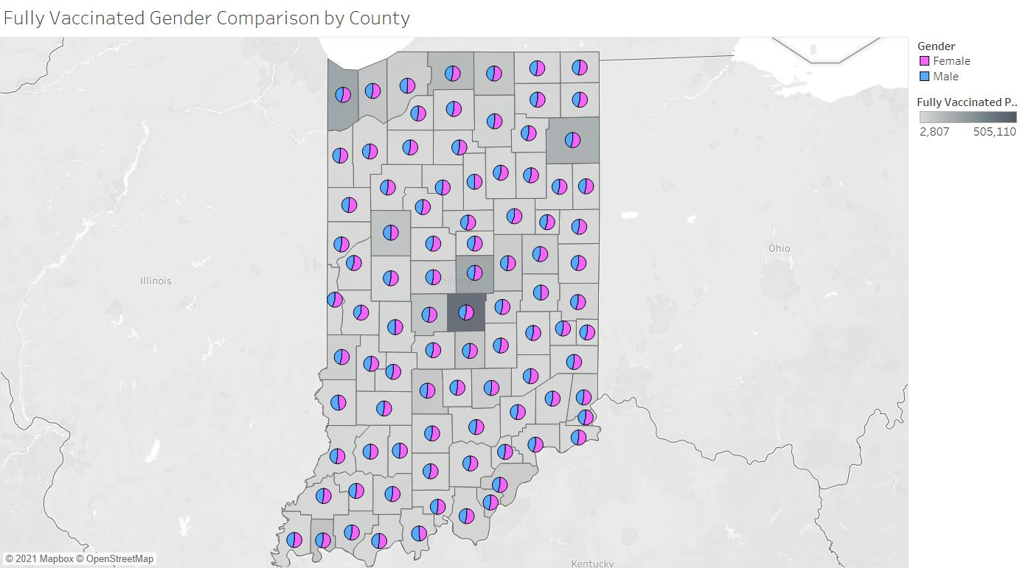
Percentages of Gender Vaccinated per County
This map shows the volume of fully vaccinated residents in each county and highlights that females are more vaccinated across all counties.

Slide 12
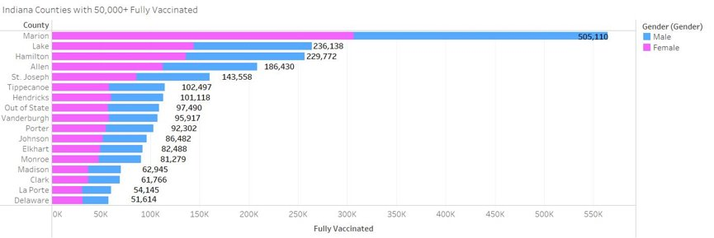
Sum of Genders Vaccinated per Top 17 County
This visualization shows Indiana counties with over 50,000 fully vaccinated residents. The biggest counties have more noticeable differences in the number of vaccinated residents. Over 50 percent of the fully vaccinated population in each county is female.

Slide 13
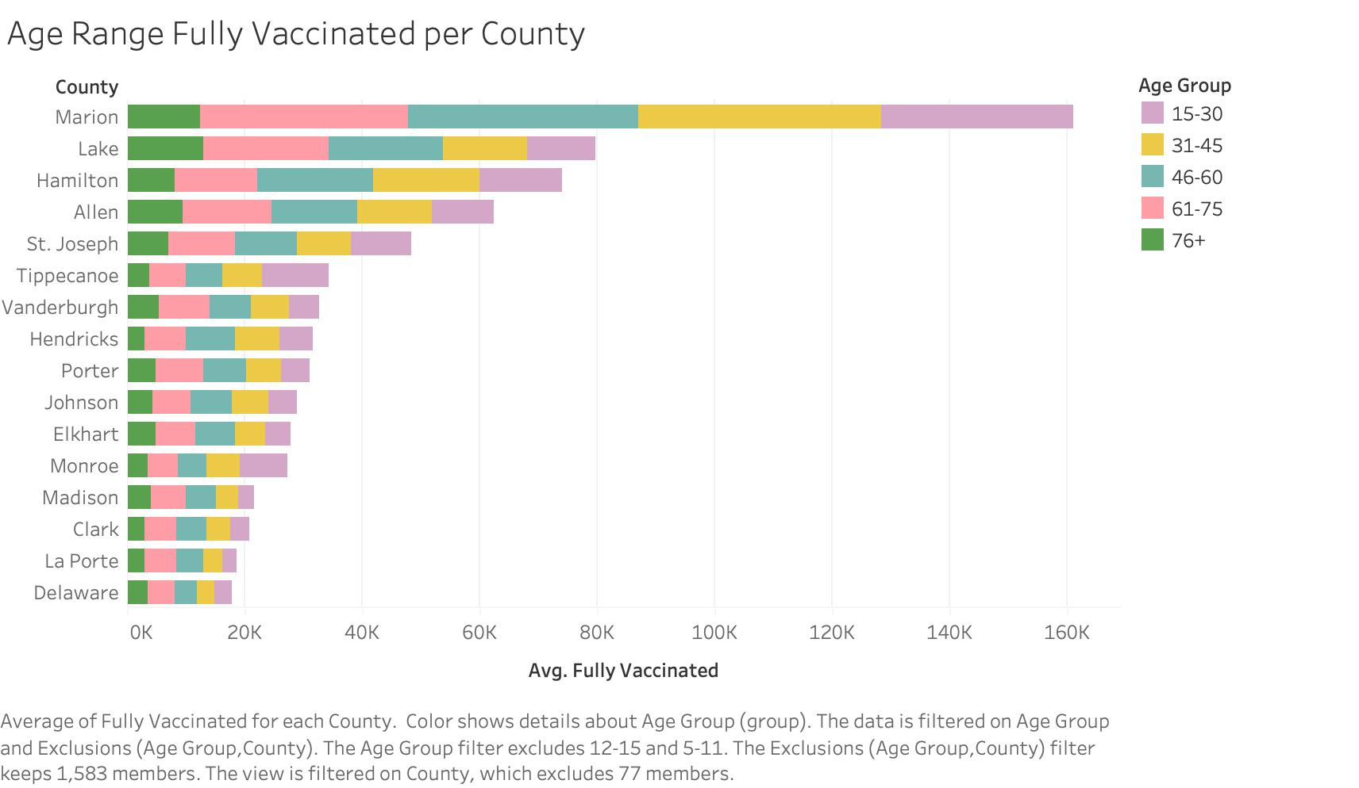
Full Vaccinated Residents by Age

Slide 14
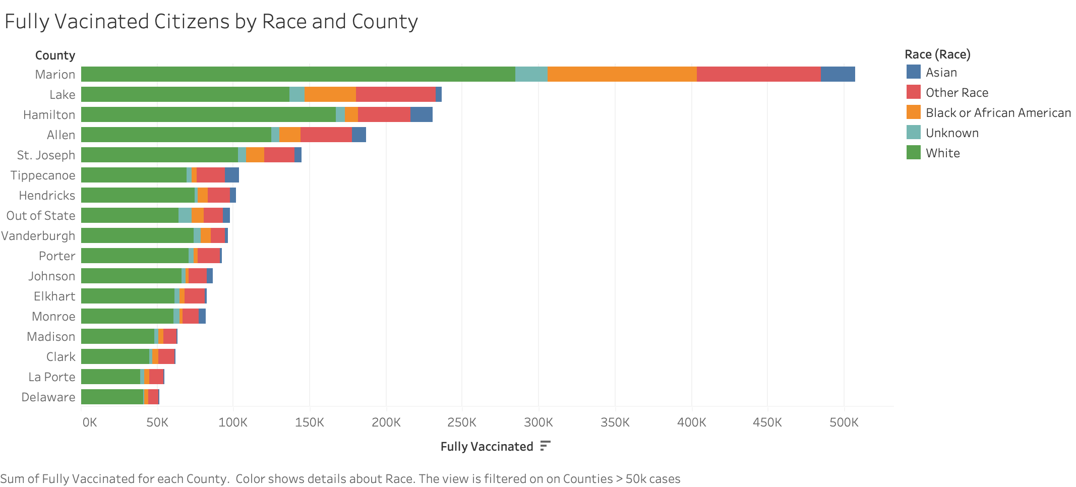
Race Visualization ---
Sum of fully vaccinated for each county > 50k cases. Color shows details about race

Slide 15
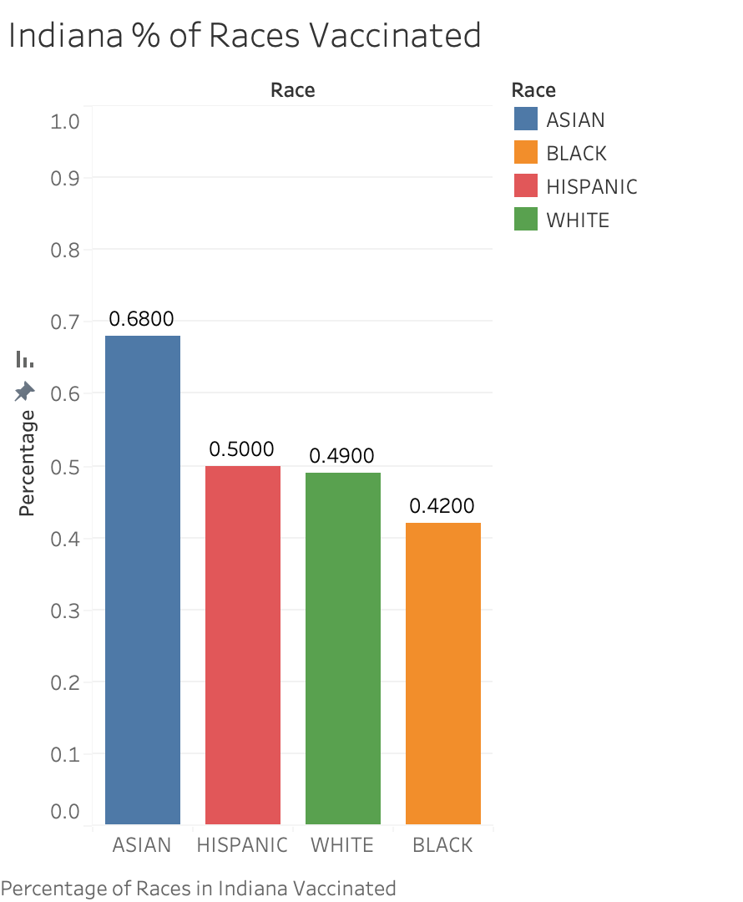
Additional Race Visualization

Slide 16
Conclusion
Visualizing data by Race, Gender, and Age brings greater insight to how different demographics responded to Covid-19.
No concrete conclusions can be made about why different demographics chose to get vaccinated but it's important to see the actual numbers of those that are vaccinated.
What our Visualizations can show is important and insightful trends that can let the audience come to a plausible conclusion of their own.

Slide 17
Sources
https://www.kff.org/other/state-indicator/percent-of-total-population-that-has-received-a-covid-19-vaccine-by-race-ethnicity/?currentTimeframe=0&sortModel=%7B%22colId%22:%22Location%22,%22sort%22:%22asc%22%7D
https://data.chhs.ca.gov/dataset/vaccine-progress-dashboard/resource/71729331-2f09-4ea4-a52f-a2661972e146
https://hub.mph.in.gov/dataset/covid-19-vaccinations-demographics-by-county-and-district\
https://www.stats.indiana.edu/topic/census.asp

Slide 18
THANK YOU!
Questions?

